Slide 1
CAR PRICE PREDICTION
Submitted by: Harneet Kaur rehsi

Slide 2
ACKNOWLEDGMENT
I want to thank my SME Khusboo Garg and Flip Robo Techniques to express our sincere thanks to the following people, without whom we would not have been able to complete this project. I have scrapped the data from Spinny which is an online car dealing website.

Slide 3
INTRODUCTION
Business Problem Framing:
: With the covid 19 impact in the market, we have seen lot of changes in the car market. Now some cars are in demand hence making them costly and some are not in demand hence cheaper.

Slide 4
Motivation for the Problem Undertaken:
Review of Literature:
In this project, we need to scrap car-related information i.e: car model, car type, fuel type, price, etc. information. From online websites. There are several websites available regarding car dealing, selling, buying cars or used cars, etc. i.e: Olx, CarDekho, Car24, Spinny and many more. I have scrapped data using one of the Data scraping technique: Selenium. I have scrapped my entire data from the online website name Spinny.
objective behind making this project is due to covid19 there is a huge effect on the market, here I am dealing with changes in the car market their changing price due to covid19. This model will then be used by the management to understand how exactly the prices vary with the variables. They can accordingly manipulate the strategy of the firm and concentrate on areas that will yield high returns. Further, the model will be a good way for the management to understand the pricing dynamics of a new market

Slide 5
Analytical Problem Framing
Mathematical/ Analytical Modeling of the Problem:
: In this project, the dataset contains several rows and columns containing all the necessary information. For removing NaN values present in the dataset we have used several statistical and exploratory data visualization for better understanding and model building for predictions.

Slide 6
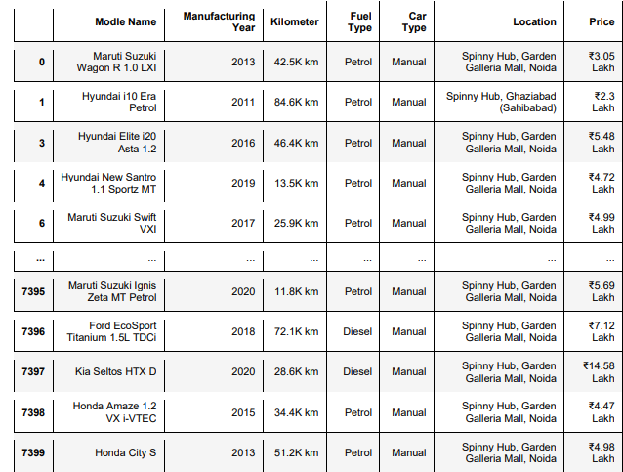
Data Sources and their formats: The data contain 74000 rows and 7 columns respectively. containing all the necessary details. Data is scrapped or originated from spinny an online car dealing website.

Slide 7
Data Preprocessing Done:
: Data contains some NaN values. To clean the data I used dropna method and drop all the NaN values present in the particular dataset. Data also contain columns with object-type data which we need to convert into numerical or encode them. So that our machine learning model understands them because the machine learning model understands only numeric type data. I have used replace method are replaced some categorical data with some meaning data by replacing them with some numbers and also used Label Encoder to encode all the categorical or object data into some label so that our machine learning model will understand the information present.

Slide 8
Visualizations

Slide 9
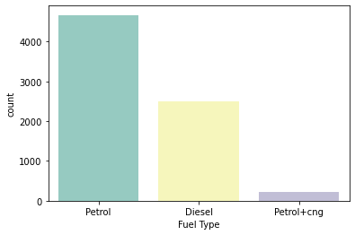
I have used the count plot here for visualizing the Fuel type of the cars As we can see that there is a huge number of cars having Petrol as their furl type is sold or bought more. Then Diesel and we can see that Petrol+cng is the least sold or bought furl type car

Slide 10
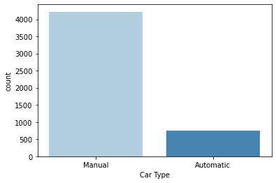
I have used a count-plot here Here it is shown that most bought and sold car type are manual not automatic. People prefer more manual cars as compared to automatic

Slide 11
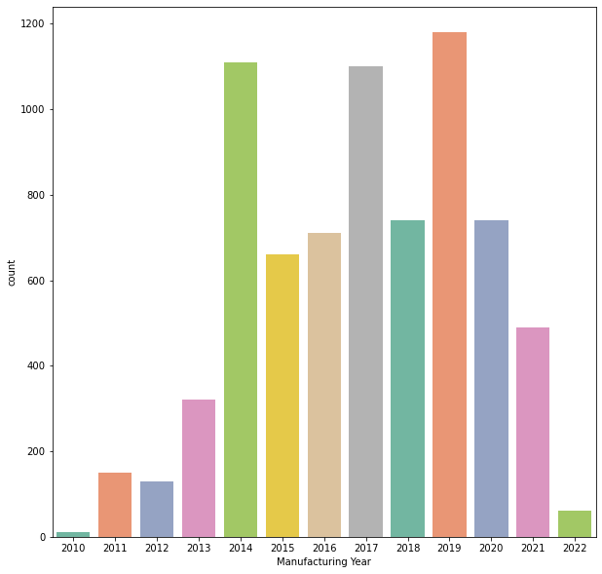
This Count-plot represents all the numbers of cars manufactured in that particular year We can see that the highest car manufacturing year is 2019 And the least manufacturing year is 2010

Slide 12
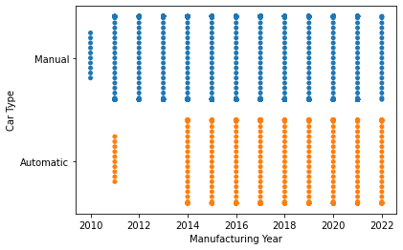
Here I have used a swarm plot for understanding the relationship between manufacturing year and car type As we can see in 2010 Manual car types were mostly used or build As the year increases the manufacturing or use of Automatic cars increases In 2022 both Manual and Automatic are equally manufactured as well as used

Slide 13
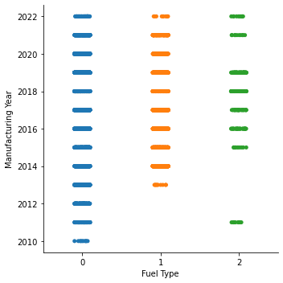
Here I have used a cat plot for understanding the relationship between manufacturing year and Fuel type: Here: 0 = Petrol 1 = Diesel 2 = Petrol+cng

Slide 14
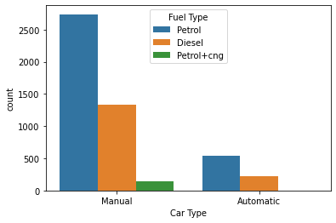
Here I have used Count plot to check the relationship between Car type and Fuel type

Slide 15
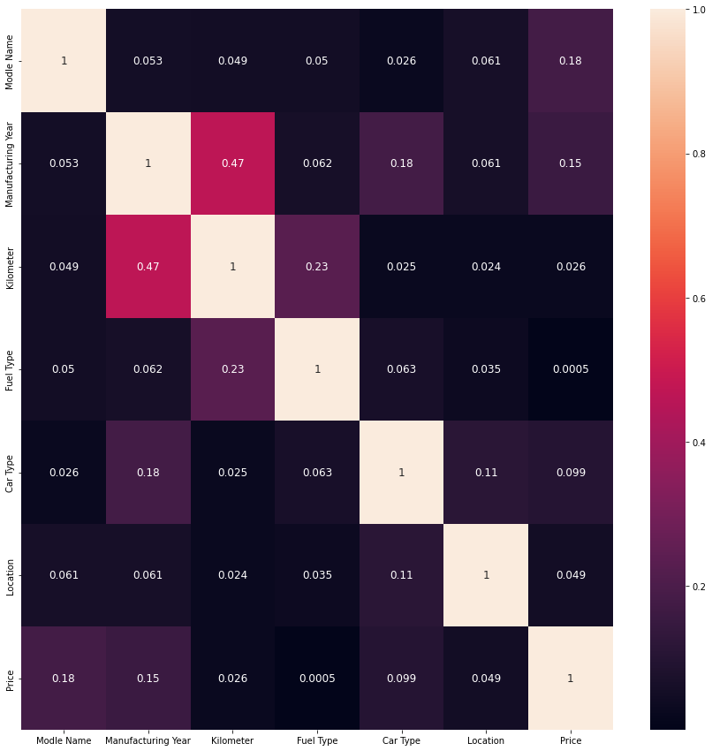
Used heatmap for checking the multicollinearity

Slide 16
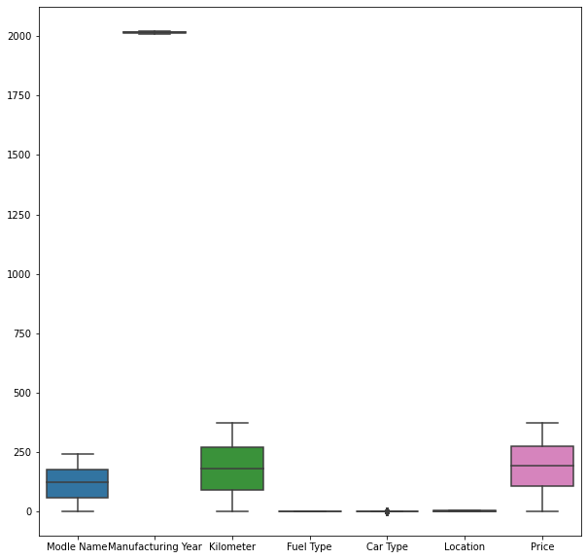
Used Boxplot for checking the outliers

Slide 17
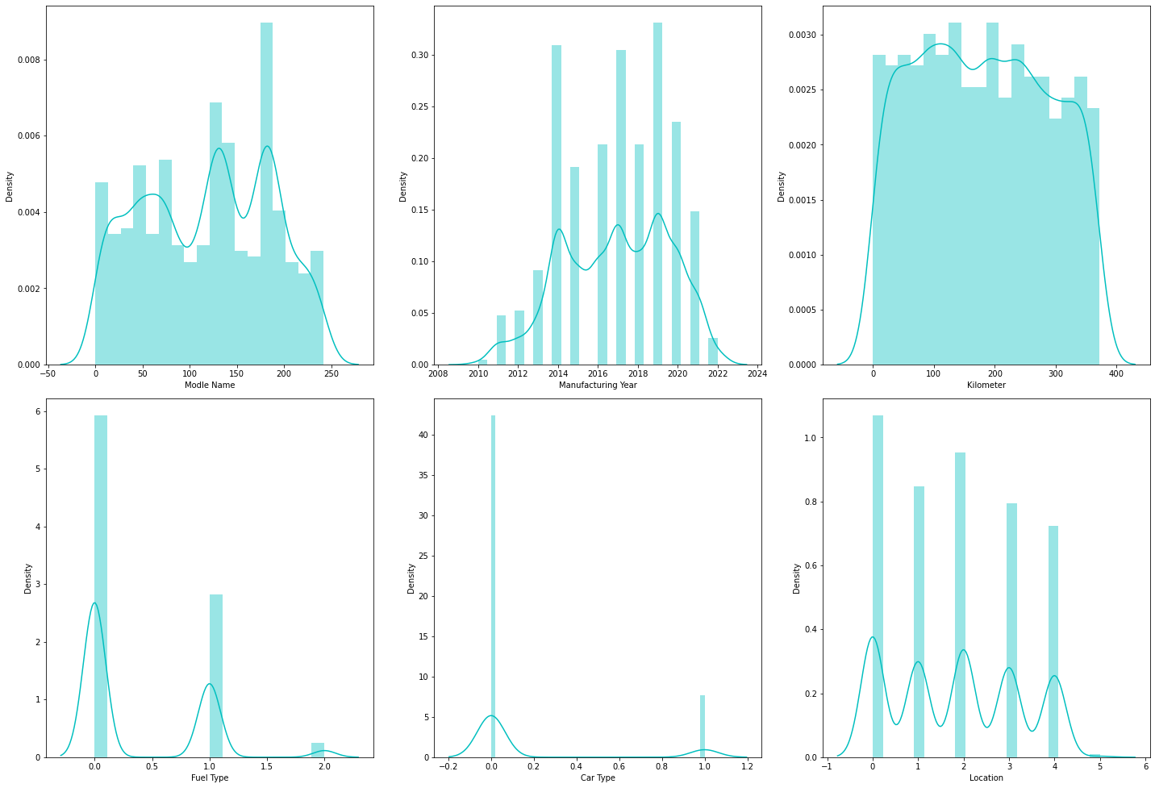
Dist-plot of features

Slide 18
Interpretation of the Results:
After visualizing the data I have concluded that 2019 is the most manufactured year as the highest number of cars were manufactured in this year and 2010 is the least manufactured year as the lowest number of cars were manufactured in this year. Petrol is the most used fuel type in cars and People prefer more Manual cars as cared to Automatic cars. In 2010 people prefer Manual cars but as the year passed people start to use both Manual and Automatic cars both equally. After using preprocessing methods to convert the data or encode the data and scale the data so that our machine learning model will understand the data properly. The model that I have built “100” accuracy rate. I have tried different machine learning models the accuracy rate is the same in all the models. For checking the model is not overfitted I used cross-validation the result came out that the model is not overfitted

Slide 19
CONCLUSION
Key Findings and Conclusions of the Study:
Learning Outcomes of the Study in respect of Data Science
After visualizing the data I have concluded that 2019 is the most manufactured year as the highest number of cars were manufactured in this year and 2010 is the least manufactured year as the lowest number of cars were manufactured in this year. Petrol is the most used fuel type in cars and People prefer more Manual cars as cared to Automatic cars. In 2010 people prefer Manual cars but as the year passed people start to use both Manual and Automatic cars both equally. After using preprocessing methods to convert the data or encode the data and scale the data so that our machine learning model will understand the data properly. The model that I have built “100” accuracy rate. I have tried different machine learning models the accuracy rate is the same in all the models. For checking the model is not overfitted I used cross-validation the result came out that the model is not overfitted.
Data contains some NaN values. To clean the data I used the dropna method and drop all the NaN values present in the particular dataset. Data also contain columns with object-type data which we need to convert into numerical or encode them. So that our machine learning model understands them because the machine learning model understands only numeric type data. I have used replace method to replace some categorical data with some meaningful data by replacing them with some numbers and also used Label Encoder to encode all the categorical or object data into some label so that our machine learning model will understand the information present. I have also tried the mode method to replace the data with some meaningful data but it doesn’t work here. So I have used dropna method insteadd

